Slide 1
AMA Guides® Achieving Equitable Impairment Ratings Through the Most Current Medicine
Montana AMA Guides Update
September 2021

Slide 2
Topics
Overview & Mission
Importance of Using the Most Current Medicine
Editorial Process &
Timelines
AMA Guides Sixth 2021
AMA Guides Sixth 2022
Content Roadmap
Implementation Resources
Stay Involved

Slide 3
Level set: Permanent impairment & the AMA Guides
An injury that results in long-term deviation or loss of a body part or body function is called permanent impairment.
Permanent impairment can often impact an injured person’s ability to work, preventing them from keeping or acquiring certain jobs and impacting lifetime earnings. Injured people often seek out compensation to make up for these losses, known as workers’ compensation.
The AMA Guides were developed to provide health professionals with a standardized methodology rooted in medicine to conduct permanent impairment ratings. The AMA Guides are the authoritative, comprehensive resource for the medical community.

Slide 4
AMA Guides, Permanent Impairment and Disability
Impairment ratings and impairment rating reports produced using the AMA Guides are used as a critical input in determining fair compensation for individuals with work related injuries.
An impairment rating is often only one input into a complex disability and compensation calculation.
Determination of appropriate compensation is the realm of state/jurisdictional governments, not physicians.

Slide 5
Mission
The AMA is committed to serving stakeholders (e.g., patients, physicians, government) with fair and equitable permanent impairment ratings that can be completed promptly without undue administrative burden.
By engaging the community of practice, the AMA Guides editorial process incorporates the best available science and evidence-based medicine, reflecting medical advances and new insights.

Slide 6
Shared Objectives
Common Ground
Physicians
Regulators
Labor
Management
Legal Community
Other Stakeholders
Patients
Notes:
The translation of impairment to compensation is not a medical process
The update process must be transparent, and must incorporate current evidence and consensus-based medicine
Technology provides an opportunity to improve consistency of application and accessibility
Systemic barriers to states “upgrading” need to be considered
Timely, trusted impairment ratings will enable patients to focus on their well-being and their return to work.
Equitable impairment rating is foundational to equitable compensation

Slide 7
Why Using the Most Current Medicine is Important
DSM-5

Slide 8
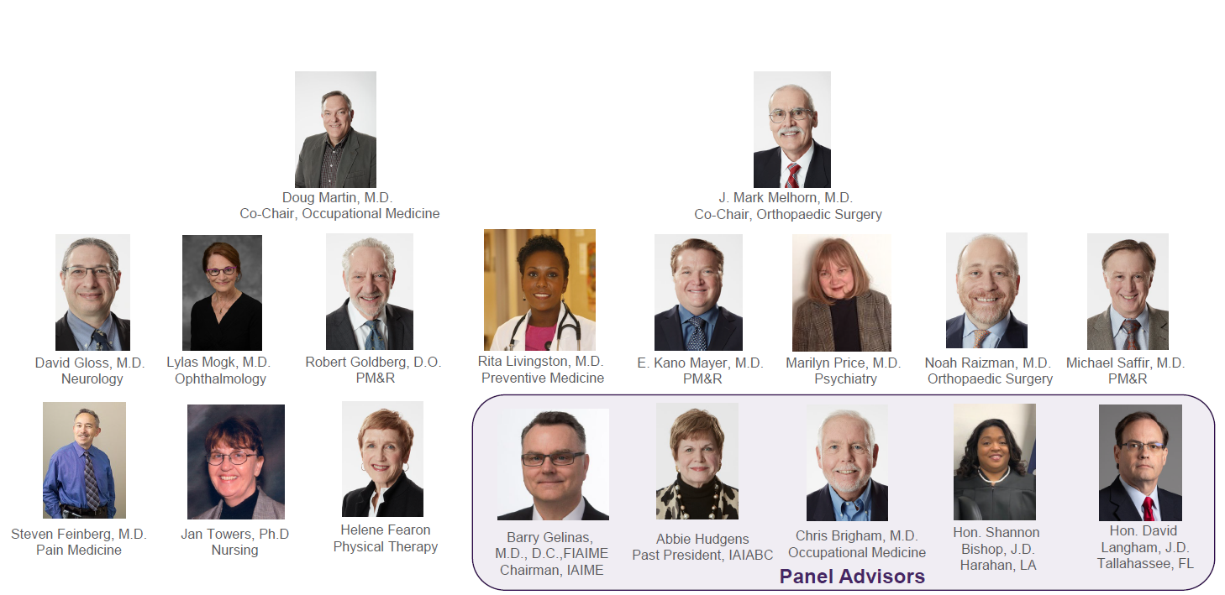
AMA Guides Editorial Panel

Slide 9
Transparent Editorial Process
Preliminary approval
Panel adoption and publication
Proposal presented to AMA Guides® Editorial Panel for approval* Proposal accepted by Editorial Panel
Publishing on scheduled cadence on AMA Guides Digital
Content development
Public comment period*
Specialty experts develop editorial change proposal for consideration
AMA Federation
Allied Health Associations
Workers’ Comp Associations
Legal Associations
Input is Advisory-only
*Opportunity for Interested Party Review/Comment

Slide 10
Content delivery activity timeline: 2021 & 2022
*Effective dates for new AMA Guides Sixth content
Launch of AMA Guides Digital
Panel Adoption of 2021 Content
Communications to State Societies and Regulators
Education Modules Available
April 1: New content available for states that mandate use of the Sixth Edition
July 1: New content effective for states that mandate use of the Sixth Edition*
AMA Guides Sixth 2021
Q1
Q2
Q3
Q4
Proposal Development
April – June: Proposals presented for Editorial Panel Consideration.
July: Panel Approval
August: Public Comment Period
Oct : New content available for states that mandate use of the Sixth Edition
Jan 1, 2022: (following year)
New content effective for states that mandate use of the Sixth Edition*
AMA Guides Sixth 2022

Slide 11
AMA Guides Sixth 2021
AMA Guides Sixth 2021
Effective July 1, 2021, AMA considers the updated AMA Guides Sixth 2021 the most recent edition of the AMA Guides and the most current version of AMA Guides Sixth. The update is based on the most current medicine as adopted by the AMA Guides Editorial Panel.

Slide 12
AMA Guides Sixth 2021
AMA Guides Sixth 2021
Content update provides clarification and updated terminology around mental and behavioral health concepts to improve interrater reliability. Overview of updates to Mental and Behavioral Health Content:
Change from DSM IV to DSM 5 terminology and methodology
Newer editions of Assessment Tools and Tests
Descriptions of Malingering and Motivation
Removal of summaries of psychiatric diagnoses and conditions from the Glossary to mitigate discrepancies in a forensic setting
Removal of GAF results in more accurate mental and behavioral health impairment ratings
Minor editorial corrections to Lower Extremity and Spine content

Slide 13
Change from DSM-IV to DSM-5
AMA Guides Sixth 2021
Advantages:
Allow evaluator to use the most recent evidence-based classification
Used by psychiatrists and mental health clinicians for the purpose of diagnosis, treatment and research
DSM-5 was first published in 2013, so submitted records will likely use DSM-5 diagnoses

Slide 14
AMA Guides Sixth 2022
AMA Guides Sixth 2022
Language describing the new evidence-based editorial process explains why the latest edition of the AMA Guides is rooted in science and best evidence.
Assists the legal community in interpreting the science and evidence behind impairment ratings/reports.
Specimen language is offered for physicians to insert in reports to understand the importance of using the most current medicine behind impairment ratings.
No changes to impairment ratings.

Slide 15
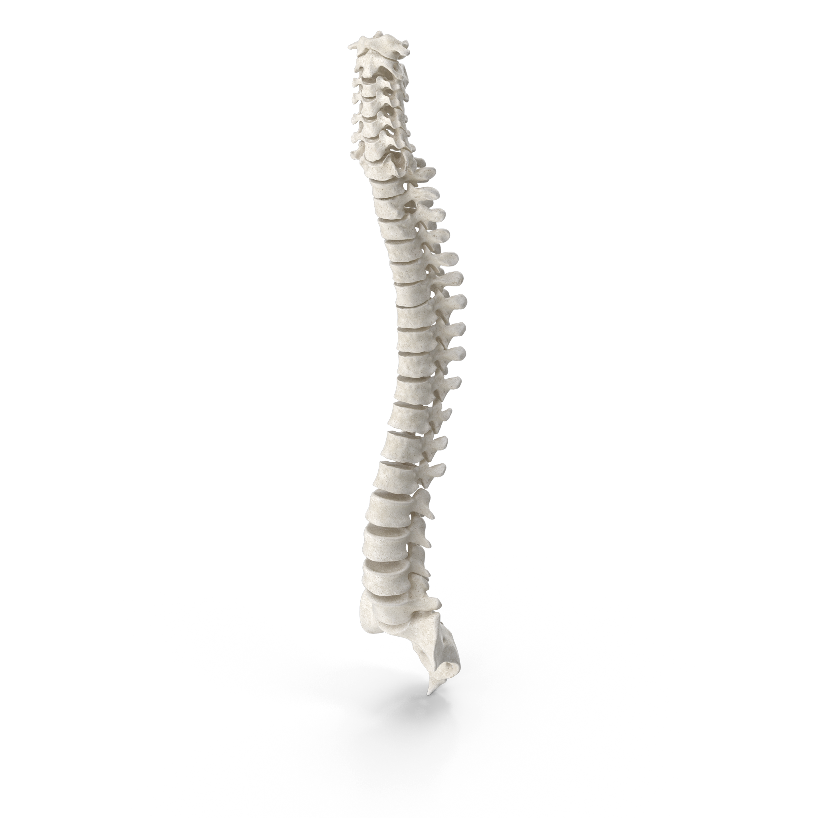
Anticipated Content Roadmap
2021
2022
Future Updates
Mental and Behavioral Health
Foundation and Principles
Ophthalmology
Spine
Neurology
Patient Reported Outcome Measures
Mental & Behavioral Health
Foundation and Principles
Neurology
Spine
Patient-Reported Outcome Measures
Ophthalmology

Slide 16
AMA Ed Hub™

Slide 17
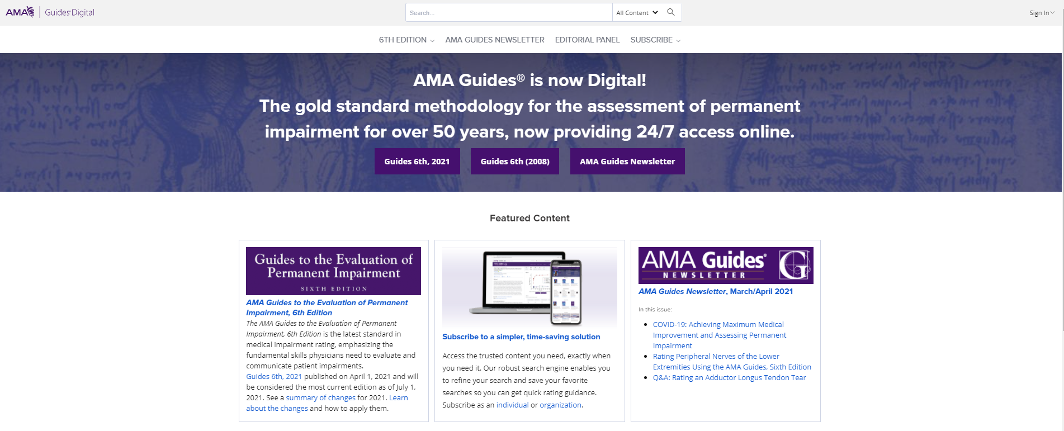
AMA Guides Digital
AMAGuidesDigital.com

Slide 18
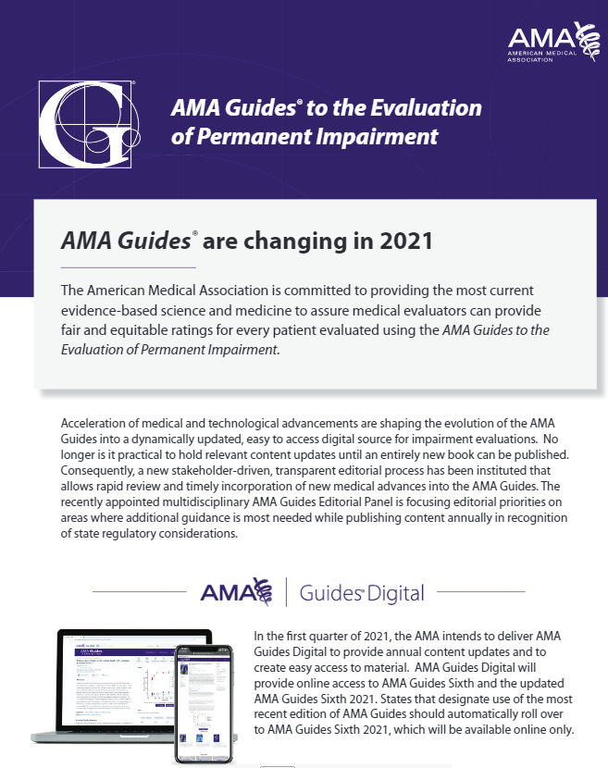
Resource Toolkit
Sample Tweet
Are you ready for AMA Guides Sixth 2021? Learn more
ama-guides.ama-assn.org

Slide 19
What does the law require in Montana
39-71-703. Compensation for permanent partial disability. (1) If an injured worker suffers a permanent partial disability and is no longer entitled to temporary total or permanent total disability benefits, the worker is entitled to a permanent partial disability award if that worker:
(a) has an actual wage loss as a result of the injury; and
(b) has a permanent impairment rating as determined by the sixth edition of the American medical association Guides to the Evaluation of Permanent Impairment for the ratable condition. The ratable condition must be a direct result of the compensable injury or occupational disease that:
(i) is not based exclusively on complaints of pain;
(ii) is established by objective medical findings; and
(iii) is more than zero.
(2) When a worker receives a Class 2 or greater class of impairment as converted to the whole person, as determined by the sixth edition of the American medical association Guides to the Evaluation of Permanent Impairment for the ratable condition, and has no actual wage loss as a result of the compensable injury or occupational disease, the worker is eligible to receive payment for an impairment award only.
(27) "Permanent partial disability" means a physical condition in which a worker, after reaching maximum medical healing:​
(a) has a permanent impairment, as determined by the sixth edition of the American medical association's Guides to the Evaluation of Permanent Impairment, that is established by objective medical findings for the ratable condition. The ratable condition must be a direct result of the compensable injury or occupational disease and may not be based exclusively on complaints of pain.​

Slide 20
Questions and Discussion

Slide 21
Get Involved
Attend Panel Meetings
Peruse AMA Guides Digital
Submit a Proposal to Update the Guides
Receive Stakeholder Updates
AMA Guides Sixth 2021- Update Summary

Slide 22
Closing
Dave Sosnow
American Medical Association
Vice President, Product Management
dave.sosnow@ama-assn.org
Victoria Riordan
Program Manager, AMA Guides
victoria.riordan@ama-assn.org
Stakeholder Update
Amy Jenkins
amy.jenkins@ama-assn.org
Notes:
Post guidance for physicians and other HCPs
Follow up communication will contain slides, toolkit materials and other information

